Slide 1

Science Journalism
Austin Shannon
Northern Arizona University
Mentor:
Randy Wilson – Editor

Slide 2
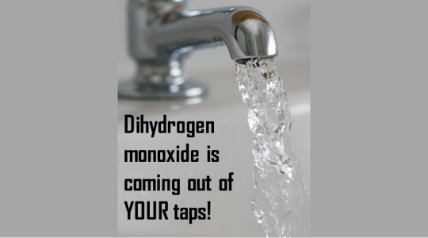



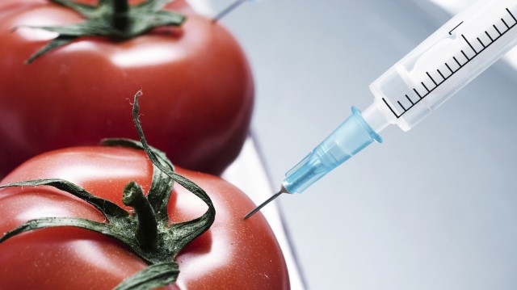

Slide 3
Good Science Journalism is…
Accurate
Engaging
Relevant
Understandable

Slide 4
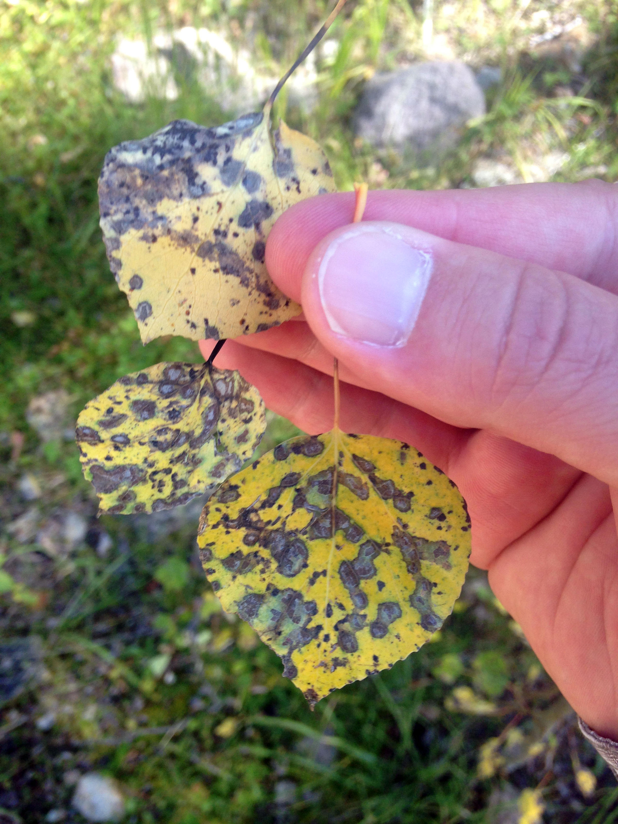
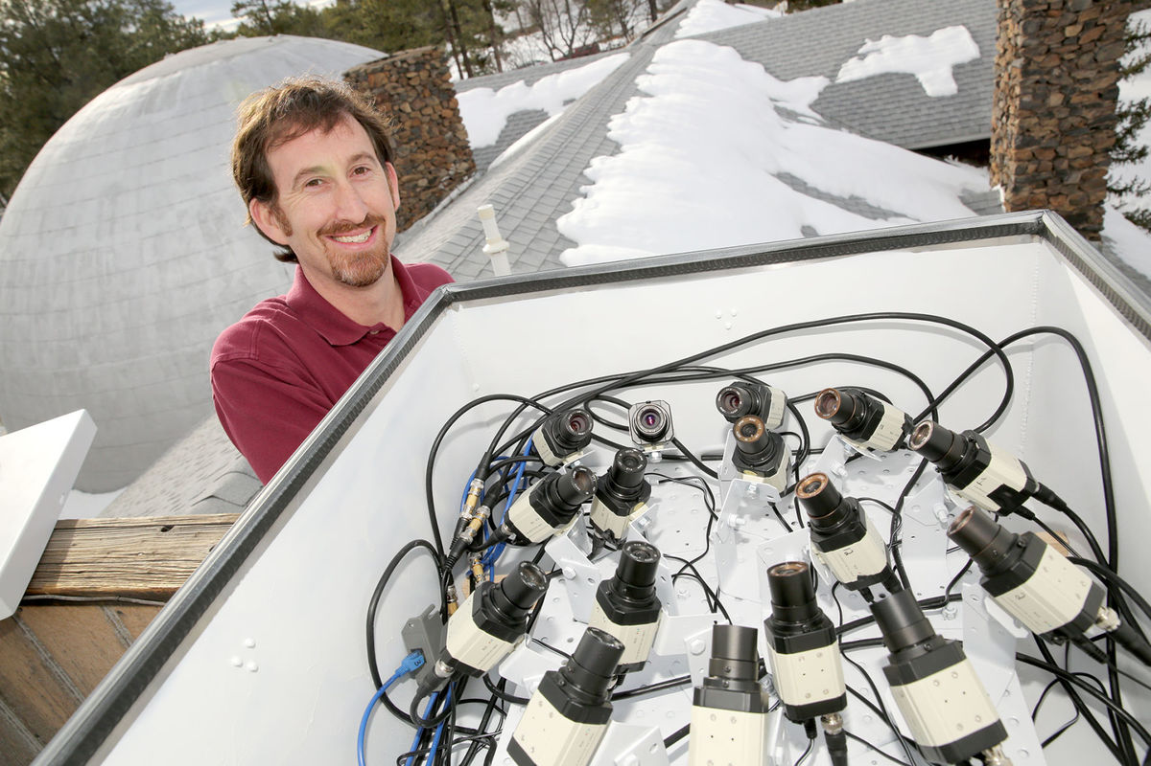
Some Stories I Was Involved In
Defoliating diseases in Aspen trees
Ground-level ozone regulations
Lowell Observatory Cameras for All-Sky Meteor Surveillance
Credit US Forest Service/Apache-Sitgreaves National Forests
Atomic force microscopy
Jake Bacon/Arizona Daily Sun

Slide 5
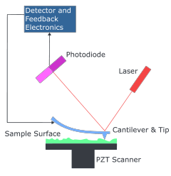
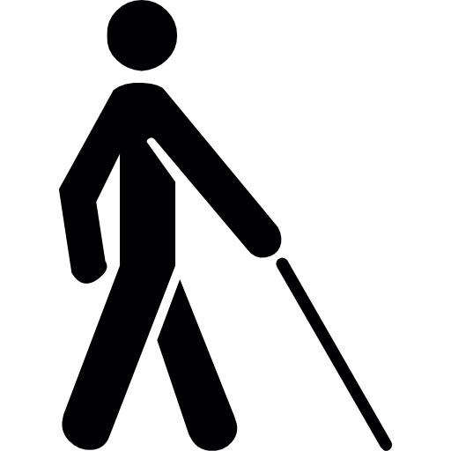
Atomic Force Microscopy
https://www.google.com/url?sa=i&rct=j&q=&esrc=s&source=images&cd=&cad=rja&uact=8&ved=0ahUKEwiDh6Dw6OvLAhUB6CYKHaQaAigQjRwIBw&url=https%3A%2F%2Fwww.iap.tuwien.ac.at%2Fwww%2Fatomic%2Finstrumentation%2Fafm&bvm=bv.118443451,d.eWE&psig=AFQjCNHqN6sjCiCaEoAn1SDptm_Bjnhlig&ust=1459544380543147
https://www.google.com/url?sa=i&rct=j&q=&esrc=s&source=images&cd=&ved=0ahUKEwixsJvG5-vLAhWKOiYKHeGjA40QjRwIBw&url=http%3A%2F%2Fwww.flaticon.com%2Ffree-icon%2Fblind-man-silhouette_8711&bvm=bv.118443451,d.eWE&psig=AFQjCNGo7qux16JuDtyHXrBY2TreedrxuA&ust=1459544024958669

Slide 6
Word-choice is important for both accuracy and understanding
“Arm” instead of “cantilever”
“Nanometer” instead of “nm”

Slide 7
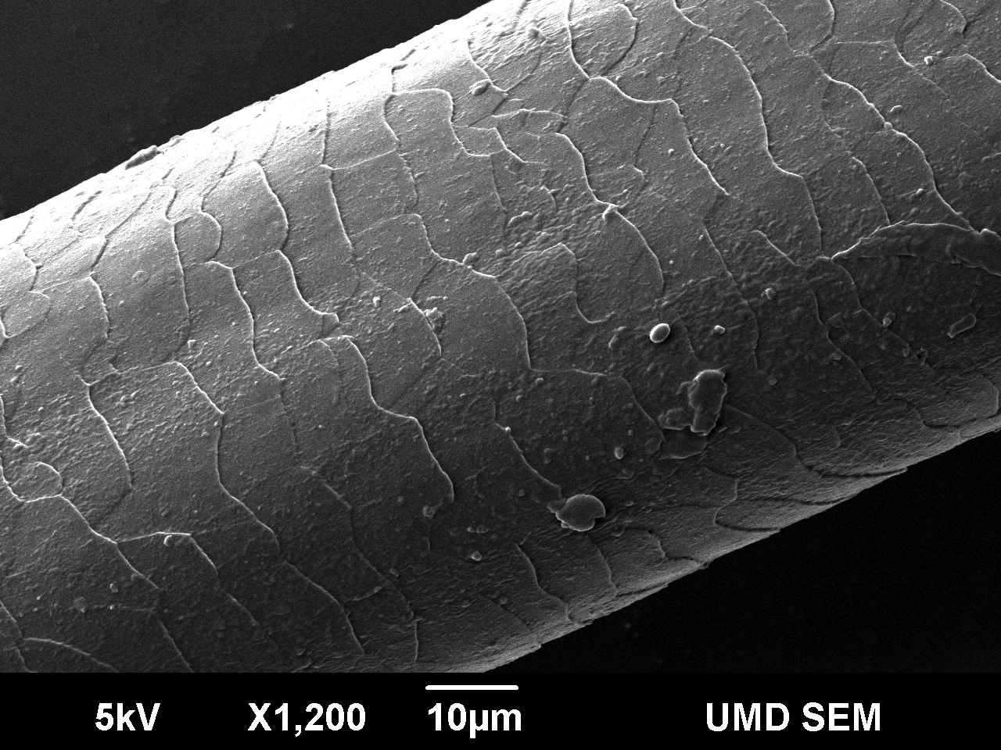
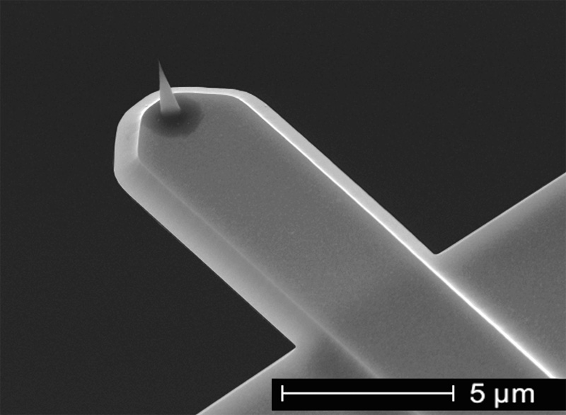
Nanometer?
Human Hair
AFM “arm” with silicon tip
http://nisenet.org/sites/default/files/images/catalog/12635/human_hair_nise.jpg
http://www.nanoandmore.com/uploads/gallery/USC-cantilever-3D-view-close-up-20131216101219.jpg
65µm
~60nm
Over 1000x smaller than a human hair!

Slide 8
Relevance?
Improved prosthetics and robotics
Better understanding of mind/muscle connection = “brain-controlled devices”

Slide 9
What I Appreciated about my Experience
Exposure to different areas of science
Interviews!
Contribution to public understanding
Enhanced communication skills

Slide 10



Acknowledgments
Randy Wilson – AZ Daily Sun
Dr. Nadine G. Barlow - Associate Director
Kathleen Stigmon - Sr. Program Coordinator

